Slide 1
The Terms They Carry
Analyzing E-Resource License Terms in Alma Analytics for RapidILL
ELUNA Learns, December 2021
Martin Patrick | patri299@umn.edu

Slide 2

University of Minnesota Context
5 campuses: Crookston, Duluth, Morris, Twin Cities, Rochester
Alma: Single Institution Zone / Multi-campus
GrOuP SeTtInGs
RapidILL
Duluth: Fall 2020
No international lending, no ebook lending
TC: Fall 2021
International and ebook lending
Most if not all licenses are stored in Alma for e-resources
Many collections are available to more than one campus, but a lot of TC content is not
Notes:
The Twin Cities (which we sometimes call UMNTC) campus is considered the "main campus" while Crookston, Duluth, Morris, and Rochester are our coordinate or system campuses. Enterprise systems, like Alma, are largely managed and maintained by the librarians at UMNTC, like me, for our other campuses as well.
So there are two important points here that make our setup more challenging - the first is that we have content in Alma that is available for just Twin Cities, or for all campuses. But we also have content that may be available only to our Crookston campus, for instance. On top of that, we prefer a single bib multiple portfolio approach which means not only do we have to separate out content that's available for Twin Cities or for Duluth for Rapidill, we also have to separate this out at the portfolio level, not just the title level. There are lots of instances where we have a title with at least one portfolio that allows lending, but that has at least one portfolio attached that does not.
Because of the way Rapid wants data in the OAI feed, at the title level, the basic process will end up publishing portfolios we can't lend into our lendable feeds, so I use a normalization rule that looks for only lendable collection IDs in the feed and removes portfolios from non lendable collections, which i’ll touch on at the end.
I specifically want to raise these things because they are an added complication that your institution might not need to deal with.

Slide 3
Goal of the Project
Use license data from Alma to create publishable, logical title sets that correspond to RapidILL's categories (journals lendable country, etc.) for the University of Minnesota - Twin Cities' implementation.
Notes:
For anyone today who doesn't live inside Alma every day, a logical set is a set that dynamically updates itself when there are changes, additions, or deletions to the metadata in Alma that changes the results of the query the set is based on. In other words, it's a set in Alma that is essentially set-it-and-forget-it.
Or to put it another way, we want to start with an understanding of which licenses allow lending sorted by their license IDs, and end up with a set of electronic collection IDs that correspond to those license IDs in order to create a publishable set of titles. The way data gets to Rapid is through an Alma publishing profile for each kind of thing, published as an OAI feed.
Also simple and sustainable workflow. Simple so anyone can kind of pick it up and start to understand what's happening and sustainable in the sense that it requires as minimal a level of maintenance as possible.

Slide 4
Today's Scope
The single biggest challenge to e-resources is identifying what can actually be lent, which is what I'll focus on today.
(I'm not a resource sharing librarian or a licensing expert, I'm a metadata librarian with a background in ERM)
The next challenge is actually translating that into a publishable set, which I will touch on but there are some big problems for us here.
Notes:
The single biggest challenge, especially when you have material for all campuses in Alma.
The biggest challenge is that we want to create a set of electronic collection IDs based on license term values in Alma. There is not a way to really do that in Alma itself. There is a way to do it in Alma Analytics, but it requires building a report in the License subject area, and then using another report in the e-inventory subject area to reference it. If you're not familiar with Alma Analytics, data from Alma is contained in subject areas that are discrete from each other. E-inventory and licenses are two different subject areas in Analytics, so you in order to get where I'm trying to go you have to do something to combine the two areas. You can theoretically get data from two different subject areas in a single report (https://knowledge.exlibrisgroup.com/Alma/Product_Documentation/010Alma_Online_Help_(English)/080Analytics/010Introduction/The_Basics_of_Working_with_Analytics/050Creating_a_New_Report), but I have never gotten it to work reliably for me, so I use an alternative method to get the outcome I want, which is a list of electronic collection IDs broken out by their lendable status.

Slide 5
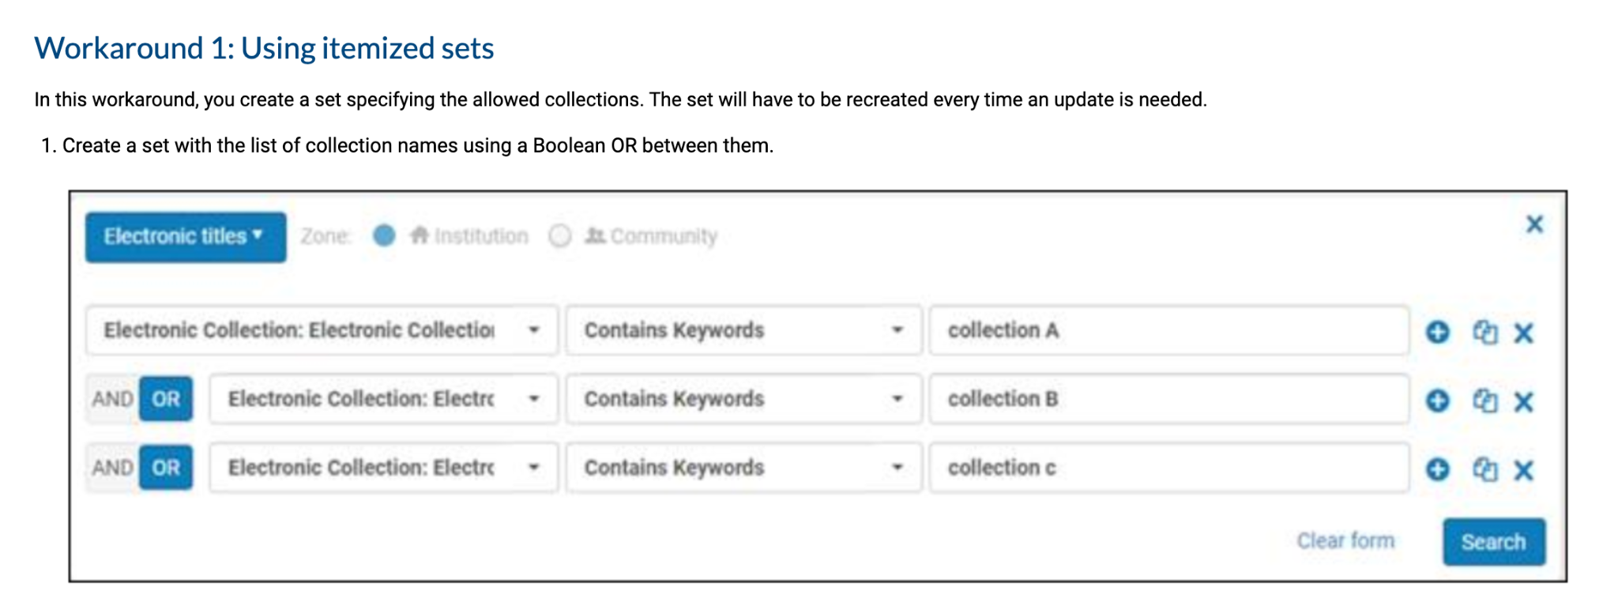
Ex Libris' Directions (at the time)
Have been updated since I first started working on implementation. A year ago this is what they looked like:
Notes:
There just isn't much available in terms of how to build these sets in a complex environment. I can't create a set of electronic collection ids like this when I have to do it for over 600 collections for one set.
No mention of licenses at all or how to define what sets to being with
Ex Libris always seems to start from the assumption that no one is set up the way we are (which is not true).
So, as you can tell, I had to invent the wheel here. Fortunately, I had worked on setting up LibKey earlier in 2020, and so I had some experience to fall back on that would end up proving useful at the later stages of the overall process.

Slide 6
What do we need to know from licenses?
We need, for each campus and for books and journals, sets:
Not lendable
Lendable country (that is, within the U.S. for us)
Lendable internationally (For TC)
Lendable Country
Not Lendable
Lendable International
Notes:
Starting from scratch. There are two buckets of material we're working with, that which we can lend and that which we cannot. Whether we can lend something internationally is actually a subset of whether we can lend something at all. This is important to keep in mind in this setup because the lendable country set in Alma will need the material in the lendable internationally set included in it to be complete. Material that is lendable internationally is also lendable within the country, so that's a subset of the data as shown here.

Slide 7
Some Caveats
We don't want to expose EBA or DDA unpurchased titles as lendable to avoid purchasing them because of RapidILL (LOL).
This requires having separate collections in Alma.
We have a lot of titles that have multiple portfolios.
Some providers may have restrictions in place beyond license terms, like ProQuest limits that may in effect prevent lending.
Our E-resources folks have done an amazing job of getting our license data into Alma.
Notes:
Most of our e-resources have more than one portfolio attached, so it's possible that a title will have a portfolio that is lendable internationally AND a portfolio that is not. Because of the way the OAI feeds publish to Rapid, we have to use a normalization rule that's based on collection ID to remove the non internationally lendable portfolio. I had to create a way to ensure non-lendable portfolios don't show up in the title level feed.
The ProQuest caveat is based on feedback I recently received from my colleagues in resource sharing and I haven't had time to fully investigate this.

Slide 8
Basic Workflow
Analytics Queries
Lists of collections IDs
Internal Description Field
Create Sets
Publish
Many queries that are simple and build on each other, rather than few queries that are complex and difficult to understand and diagnose problems within.
Collections are broken out to lendability, campus, and book/journal.
We update the internal description field with tags:
rapidill_localonly
rapidill_country
rapdiill_international
Use logical sets for each feed. That is, one set is Duluth Lendable E-Journals, another is Duluth Not Lendable E-Journals, etc.
Publish each set.
Notes:
I'll talk a little bit about how to get these tags into the internal description field at the end. I use a broad tag because many collections are available to more than just the TC campus, and then I use the actual logical set and normalization rules during publishing to ensure it's the material for the right campus.
As you can see i have three tags that i’m using, i do this because if one of our other campuses wants to implement rapidill it’s easy to create new sets in Alma off this data. If i had really specific tags, i’d have to enter a bunch in this field in some collections and it would get cluttered and increase the possibility of confusion down the road.

Slide 9
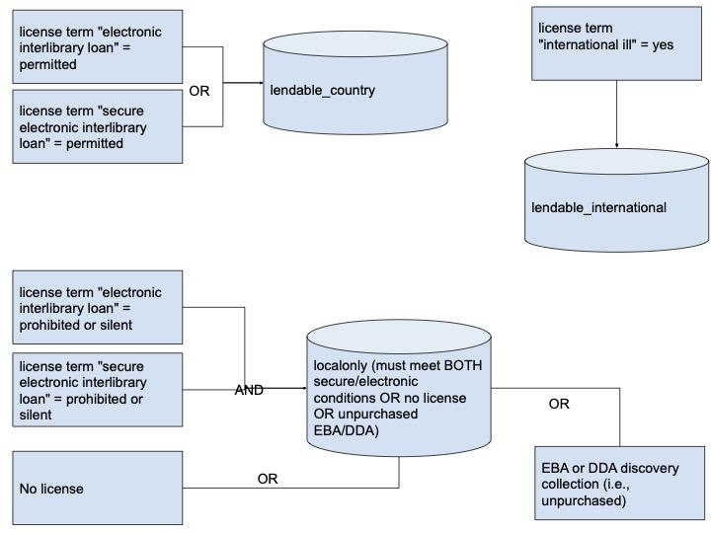
Analytics Report Logic
Notes:
This is for future reference, I know it might not display well for some people today.
If the international ILL term is yes, it's lendable internationally. Remember that this is a subset of lendable material in the first place, so we can assume if we can be lent internationally, it's lendable through RapidILL. Of course, to be sure, I added a filter in the final international report that checks that the collection is not on the list of print/fax only lending.
If both e-ILL terms are prohibited or silent, there's no license attached, or it's an EBA/DDA discovery only (that is, unpurchased title), it's not lendable.
So from here, we have three reports and we can use these to build the reports that tell us which collection IDs by campus and material type. We can also use these to build reports of new collections that we haven't tagged before.
I had some issues with my basic setup recognizing license amendments, so I had to create a couple extra reports beyond this to get at that data
So each of the boxes are a single report, and i’m going to combine them using other reports that reference these reports in Analytics. .

Slide 10
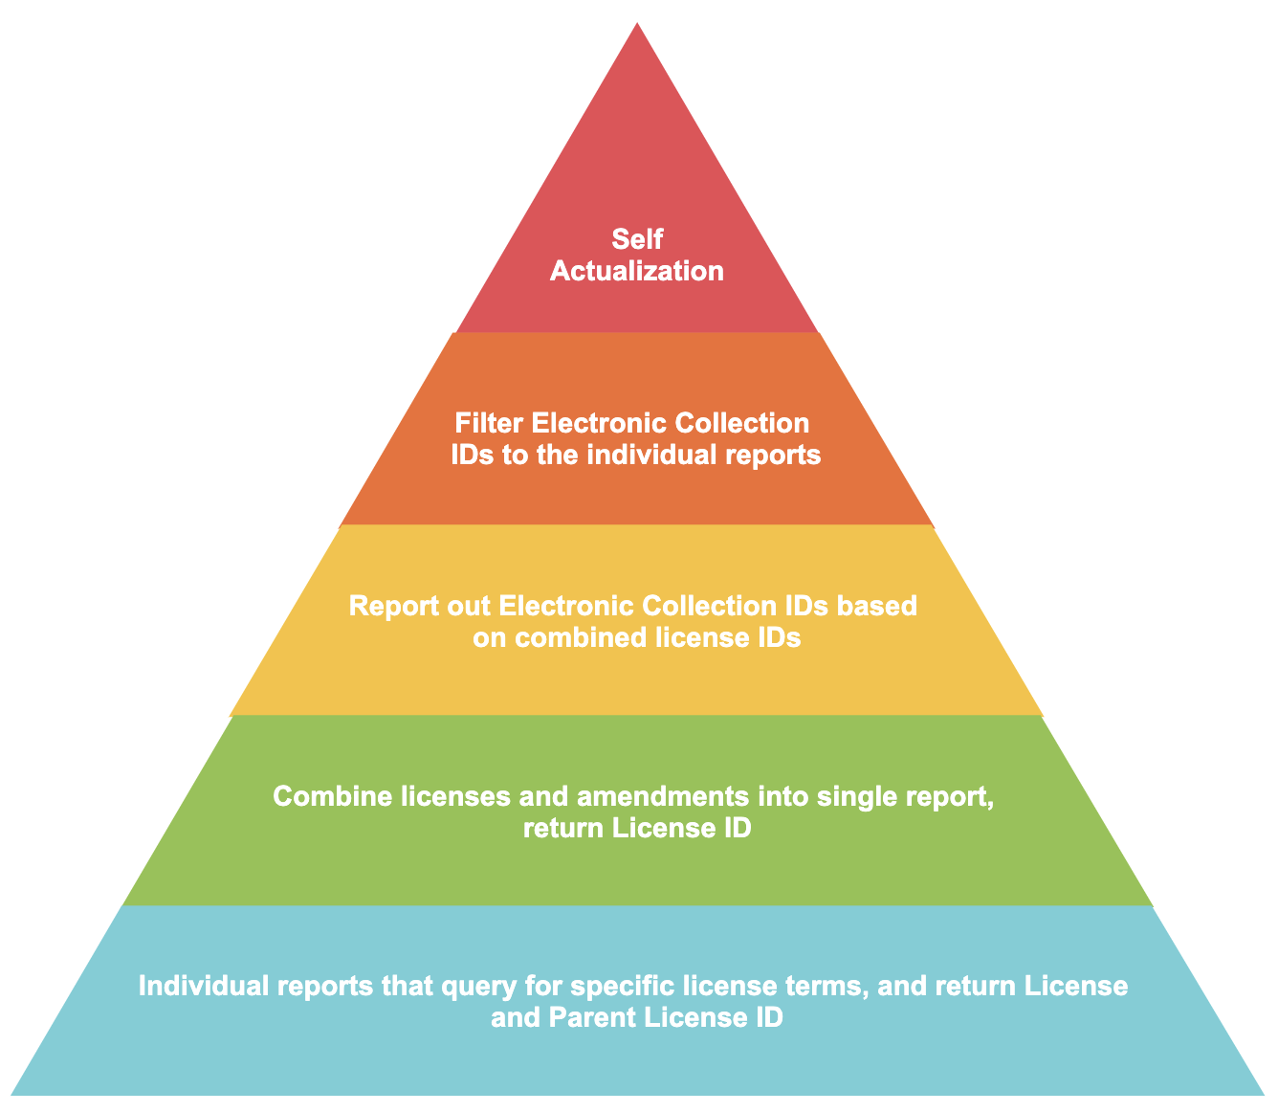
Notes:
Moving from the basic report logic, here's the basic structure of how the reports work. They build on each other, and each level of report refers to reports from the one below it, which I'll show you how to do in a minute. At the bottom, we have many individual reports that query for a specific thing, like licenses where the term secure electronic interlibrary loan is equal to permitted.
Next, we take all of these reports and combine them so that we have licenses and amendments that deal with these terms in one report. That is, we have one report that includes all the license IDs that allow lending, for example.
Next, we use the license ids from that report to build a report of electronic collections that are governed by those license ids. Remember that Licenses and E-inventory are separate subject areas in Alma Analytics and require some extra effort to combine this kind of deep analysis.
Lastly, we filter those electronic collection ID reports down to what we need within ALMA. For instance, in order to tag a collection, I need to know all the collections that are lendable. Then, I take thatlist of those collections' IDs and will go into Alma and update the internal description field. Then I use the logical set itself AND normalization rules in publishing to ensure that the TC lendable ebooks feed only contains ebooks, only contains lendable collections, and only contains material for the Twin Cities.
And of course, if you survive this workflow, you achieve self actualization.

Slide 11
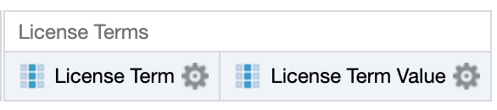
How to view license term data in Analytics
Notes:
Ok, so how do you actually query license terms in Analytics? You need to use a pairing of dimensions.
Step 1: choose create an analysis, and select the Licenses area.
Step 2: from the sidebar, add License Term and License Term Value. I experimented with adding more than one license term filter at a time, but found it unreliable so I built the reports to be just one specific thing at time. You can try that, you can also try bins or perhaps using a formula if you're an advanced user, but I found that for me and for making things as simple as possible, this worked best.

Slide 12
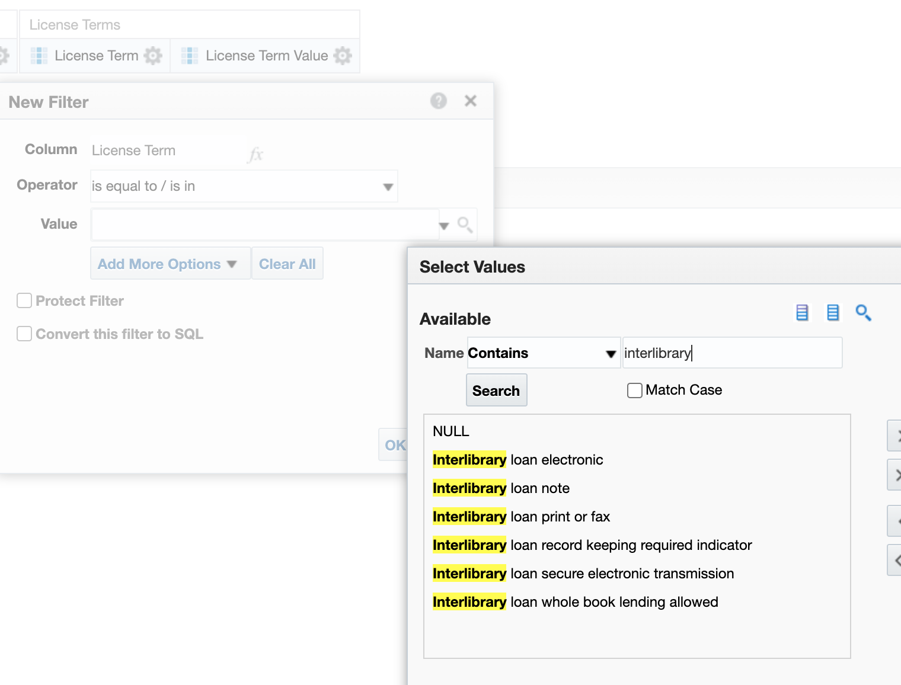
How to view license term data in Analytics
Notes:
Step 3: Add a filter on License Term. This will open the new filter dialog, and from there click the magnifying glass. Enter "interlibrary" in the "contains" option and hit search. Then choose one of the options. Here I'm gonna grab the term interlibrary loan secure electronic transmission.

Slide 13
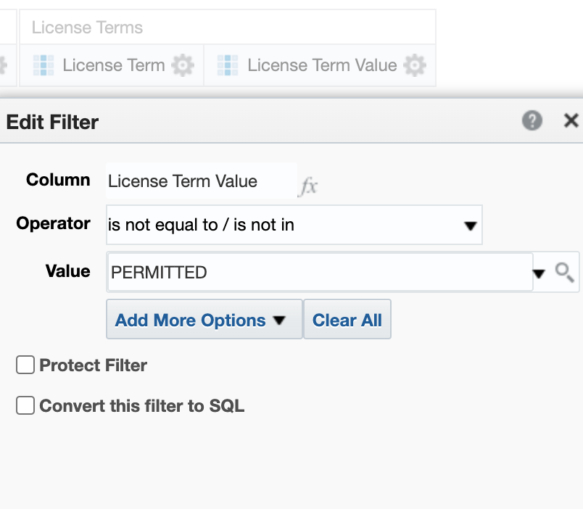
How to view license term data in Analytics
Notes:
Step 4: Add a filter on License Term Value.
In this case, I'm going to choose "Interlibrary loan secure electronic" is not equal to permitted.
Why not equal to permitted? I know from looking at the raw data in Alma and talking with colleagues who work with this data, that the three options here for us are permitted, prohibited, or silent. By choosing not equal to permitted, I'm capturing both prohibited and silent terms, as well as anything where the license value may for some reason be empty.
If you haven't set up licenses in Alma already, you may need to do some set up work. One of the ways to do this is to enter a license term in the set up area, and then you can choose the option "LicenseTermsPermittedProhibited" and you'll be able to then work with licenses and set the value to these. I've linked to more information in the slide notes, which you'll be able to access via a link I will share at the end.
See: https://knowledge.exlibrisgroup.com/Alma/Product_Documentation/010Alma_Online_Help_(English)/020Acquisitions/110Configuring_Acquisitions/170Managing_License_Terms and https://knowledge.exlibrisgroup.com/Alma/Product_Documentation/010Alma_Online_Help_(English)/020Acquisitions/110Configuring_Acquisitions/160Configuring_Sections_Order

Slide 14
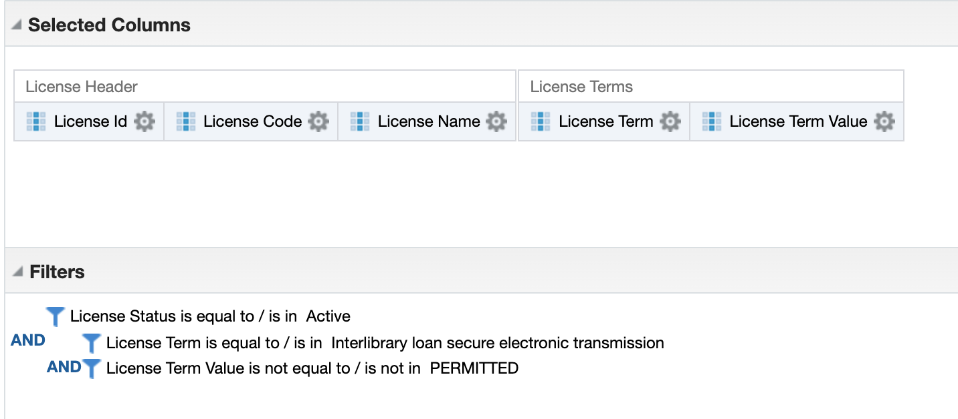
Full report criteria
Notes:
So here's what the full criteria looks like for the term interlibrary loan secure electronic transmission is not permitted (that is, silent or prohibited, or I suppose, null). this is the first level report that the rest will be based on

Slide 15
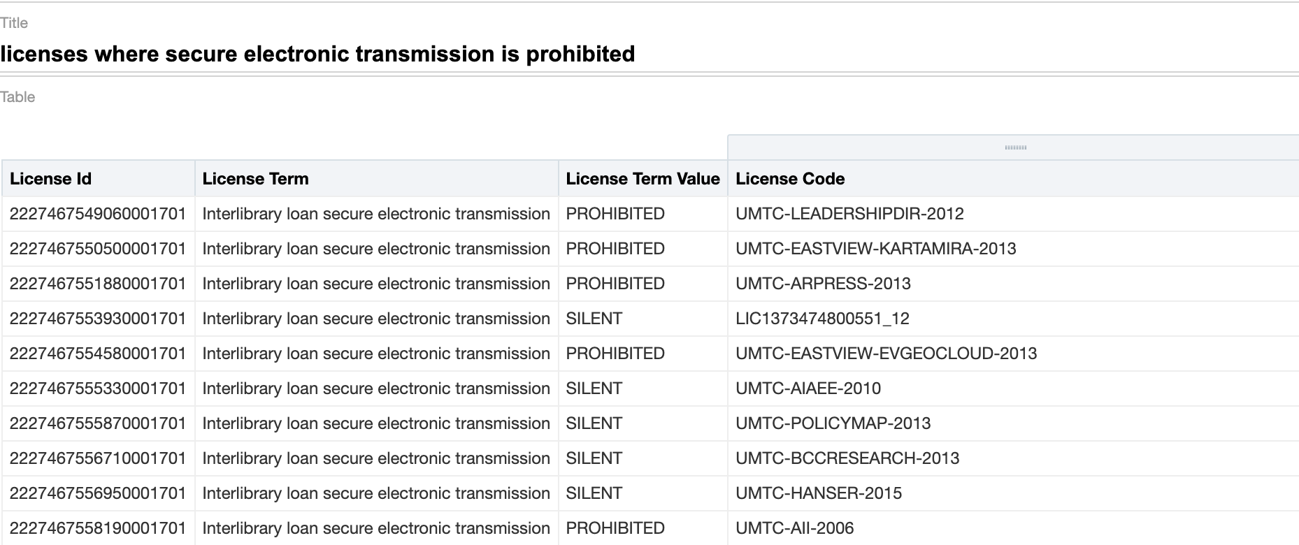
What this report returns
Notes:
You can see that we're getting both silent and prohibited values here. We're currently interpreting silent as prohibited to be conservative. This is the basic query structure for the first level of reports. I look for one license term value per report, and return the License ID and License Code for that readability. As you can see the code kind of tells you what the vendor may be.

Slide 16
List of First Level Reports
Electronic ILL = permitted
And amendments
Secure electronic ILL = permitted
And amendments
Electronic ILL ≠ permitted
And amendments
Secure electronic ILL ≠ permitted
And amendments
International ILL = yes
And amendments
EBA/DDA Discovery (Unpurchased) Collection IDs
No License
Notes:
Think of this whole process as a pyramid. These reports feed into the next level in various combinations, and by keeping them bite sized i can reuse them for other things later as well, which feeds into the final level. The EBA/DDA report is a list of known discovery collection IDs by itself. It's not actually really a query. Initially, this was the extent of the first level reports. All of these reports are just a single pair of license term and license term value, which I'll combine in the next step.
However in my testing, I realized that Analytics was not picking up collections where the collection's attached license was an amendment. So I had to create "license amendment" reports for the first five reports on this list, as well. If you're not using amendments like this, you can ignore that issue, but I'll take a minute now to show the fix that I found that works.

Slide 17
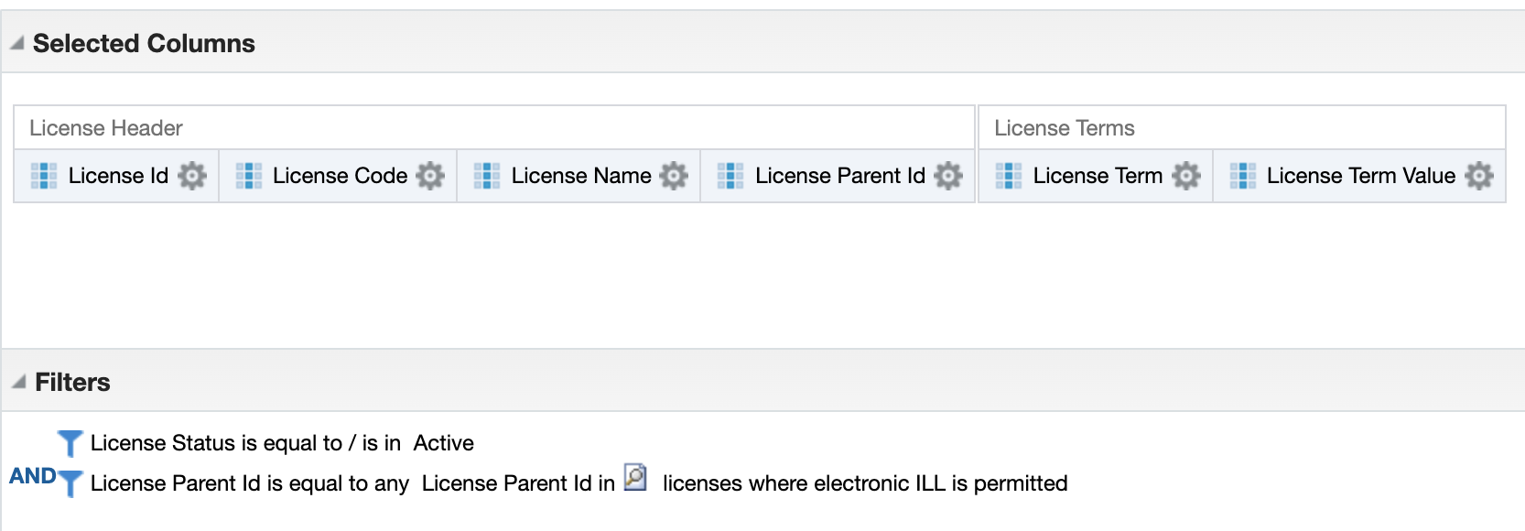
Picking up License Amendments
Notes:
I don't know if this is a bug in Analytics or a defect in my current approach, but this is how I found a way around it, and that I validated by going through quite a number of these by hand. In the initial reports, add the column License Parent ID (for full, non amendment license, the parent id will be the same as the license id), then build a report that references that report. In this case, I built a report called licenses where electronic ILL is permitted. You need to use License Parent ID though because you can't build a report based on another, and have License Parent ID reference License ID on the original report. They have to be the same dimension, at least as far as I can tell.

Slide 18
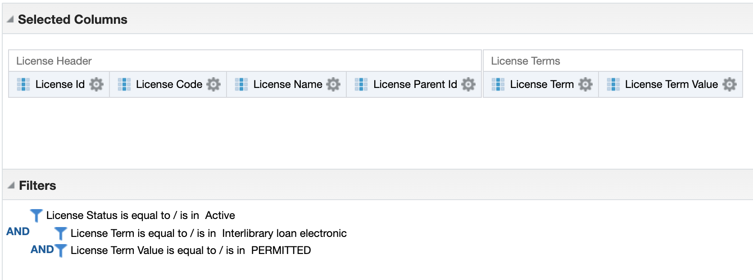
First level report criteria, final version
Notes:
So here you can see, this looks just the like other basic report I showed just a few minutes ago, only I've added the License Parent ID dimension, which remember for a base license is the same ID as the license ID itself. Now the amendment report can refer to this, and find license amendments.
And this discussion here makes a nice segue into talking about how to actually build a report using another report as the input basis.

Slide 19
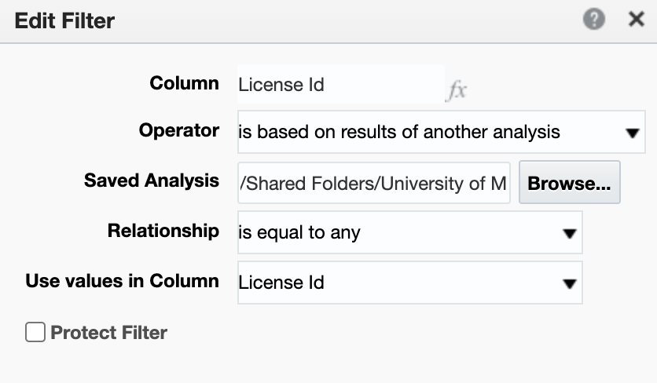
How to Reference Other Reports
Problem: you can't run a single report with e-inventory AND detailed license terms.
Solution: we have to create a series of reports that reference each other.
Notes:
So, quick refresher on Alma Analytics. Data is a day old. Subject Areas are fairly useful but can be restrictive, as here where in order to generate a report of lendable e-resources I have to work in the subject areas of Licenses and E-Inventory. But I can't pull in details about licenses in the E-Inventory area, and I can't pull in the full details I want in the Licenses subject area. The only requirement here really is that the use values in column have to match, like any basic database primary-foreign key relationship. You can use that to mashup data as long as you can get a value match between the two subject areas.
While the e-inventory area does have license data available, it's limited to identifier. So in order to built a set of electronic collection IDs from detailed data about licenses, it's necessary to build a license term value report, and then use license id as a key in the electronic collection id report.
So we built our first level reports that are license term value reports, and now we'll build our second level report that combines all of the licenses for various lendable statuses into one report.

Slide 20
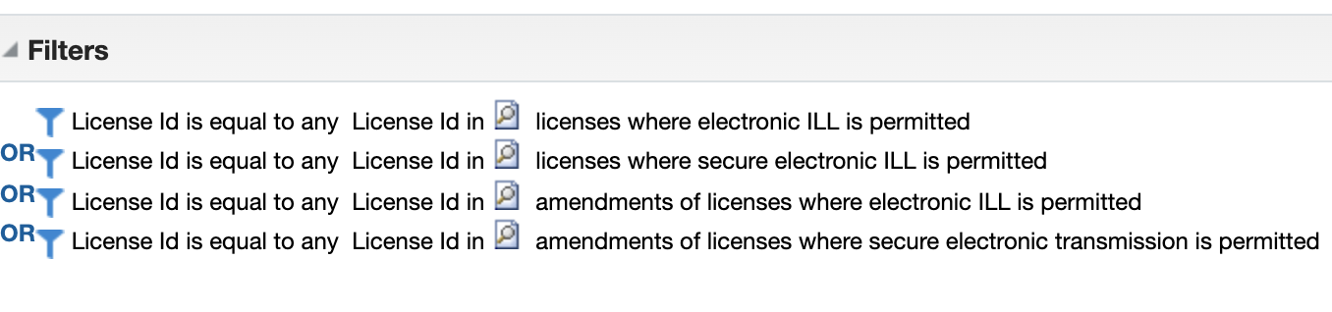
Second Level Reports
ILL is permitted (shown below)
ILL is not permitted
Notes:
The second level reports combine the individual reports into one report of license ids by category. Remember for not permitted, we need to gather up things without a license, things in the EBA/DDA discovery only collections, and things where the licenses prohibit electronic ILL.
This is the report called combined licenses allowing ILL (that is ILL is permitted). So these reports refer to other reports based on License ID. We need to this second level to combine data, before we finally start gathering the electronic collection IDs in the next step. You could skip this level, and go straight to making the electronic collection ID reports.

Slide 21
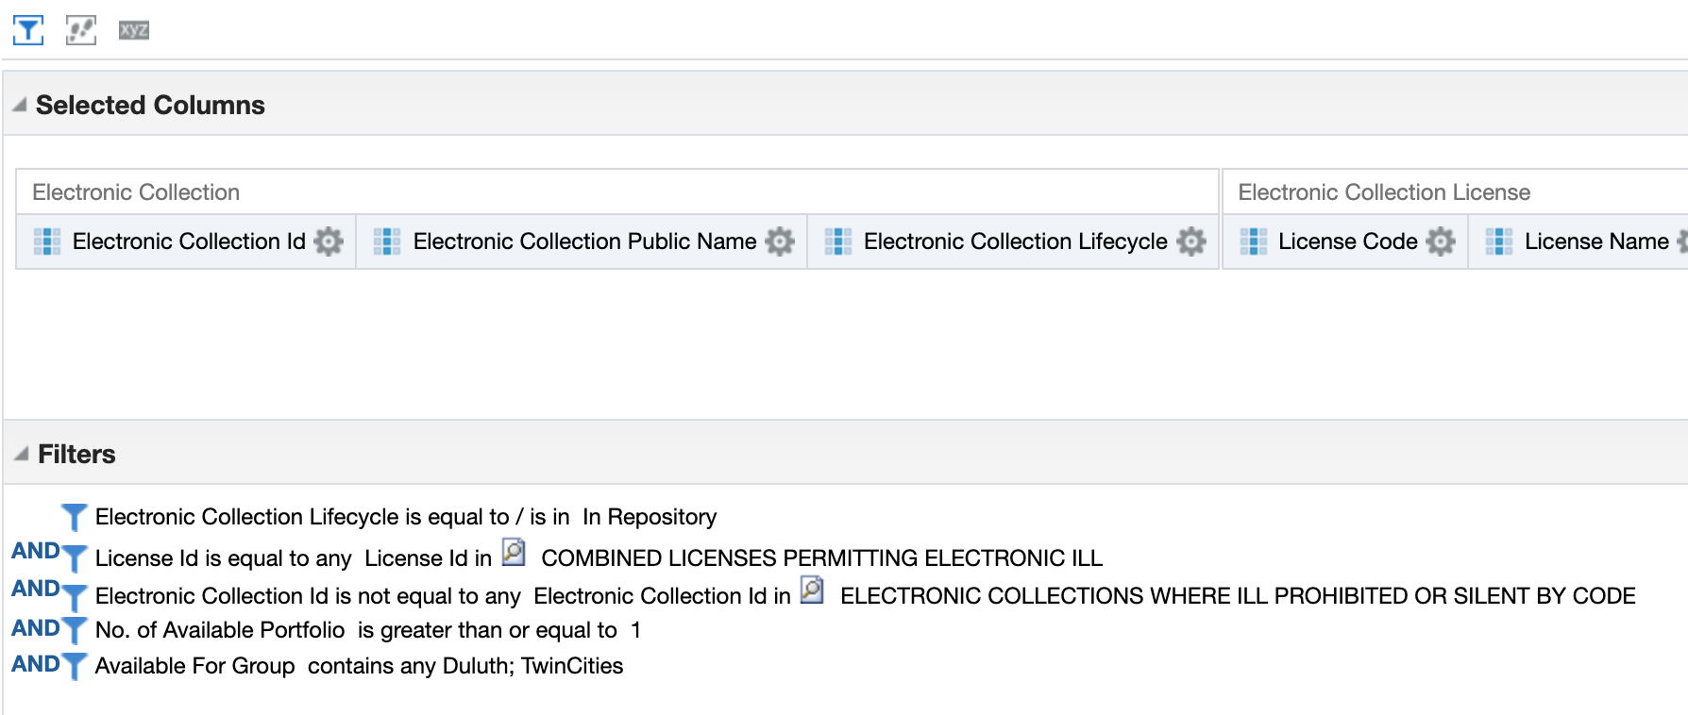
Third Level Reports
Notes:
This third level report is going to be in the e-inventory subject area and references the combined licenses allowing and the combined license prohibiting ILL. The combined prohibited one includes the licenses where both electronic and secure electronic are not equal to permitted, or amendments that say the same thing.
The Combined licenses report from this screenshot is the one on the previous slide. The "prohibited or silent" report includes all of the ones where licenses outright prohibit lending, are silent, there's no license, or that are an EBA/DDA discovery collection.
You can see here that I'm taking anything that's available for either the Twin Cities, Duluth, or for at least both. This is because I'm using a generic tag system in Alma that I'll talk about in a minute and will use Alma's logical queries to filter down to the campus I want. You could also add a filter here for books, journals, or both if you wish.

Slide 22
Final Steps
International ILL lendable
Lendable Country
Local only
Notes:
As you'll recall, we'll filter the reports down to campus and material type within Alma itself as part of the set creation and publishing profile process. The way I do this is to take the report, like the combined licenses permitting ILL and output the electronic collection IDs.
Now at this point, things get tricky. We found both the Cloud App and the Alma APIs to be unreliable. In one case in testing in our Sandbox, the group settings of a collection were wiped out by the API. Obviously for us that's unacceptable, and we reported it, and gave up on using the API. Since there's no good way to see all of the changes to every collection when you run it like that we felt we couldn't trust it so we abandoned it. Instead, I entered the tags by hand.
As I mentioned, I accepted every material type that we have, not just books and journals, and tagged the collections as you'll see on the next slide.Someday maybe we can lend audio and video, and if they don’t have books or journals they get filtered out by my Alma query and my normalization rules.

Slide 23
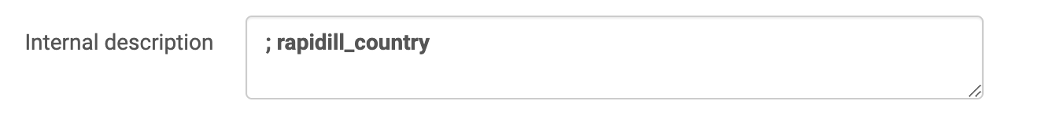
What that looks like
Notes:
So I'll quickly show you what that looks like, since I think i have the time.
For any collection on my reports, I add a tag in the internal description field of the electronic collection. Really simple. Once this is done, it's easy to build a logical set in Alma of what you need.

Slide 24
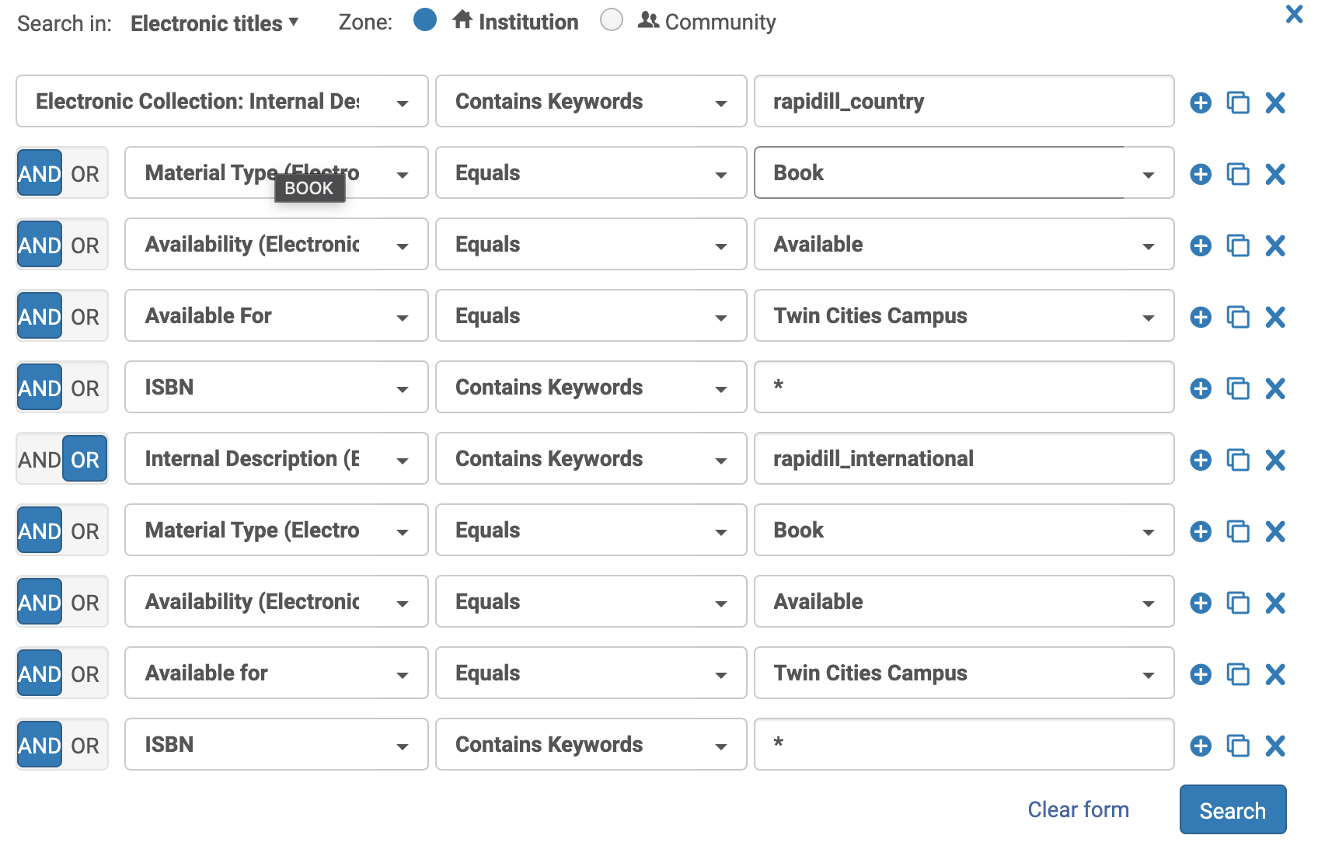
What that looks like
Notes:
here's a logical set for TC ebooks that we can lend in the "country" category. I chose to tag international lendable with one tag, and country only with a different tag, so I need to search for both in Alma. Because international is a subset of the overall lendable titles, and can be lent within the US, too, I need to add them back together here. If you've made sets in Alma this is probably pretty basic to you, but again remember that we have to use Group Settings here so that's why I need to the available for filter. I also added an ISBN wildcard query because that seems to be the basis for Rapid's matching and that trims down the set quite a bit so it's faster to publish and harvest.

Slide 25
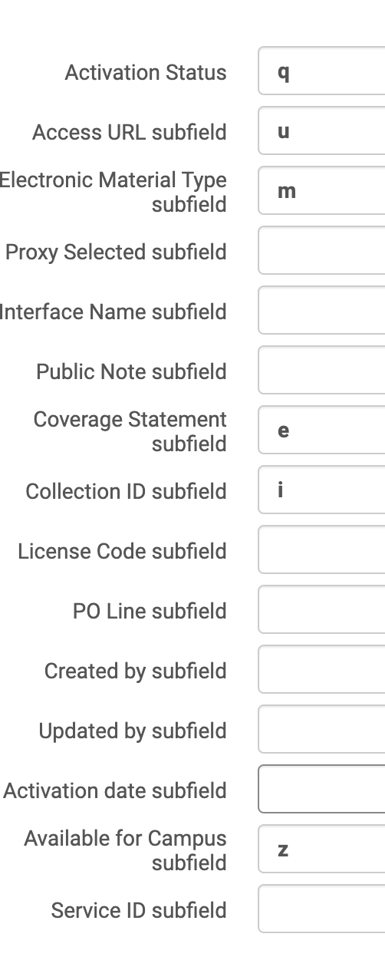
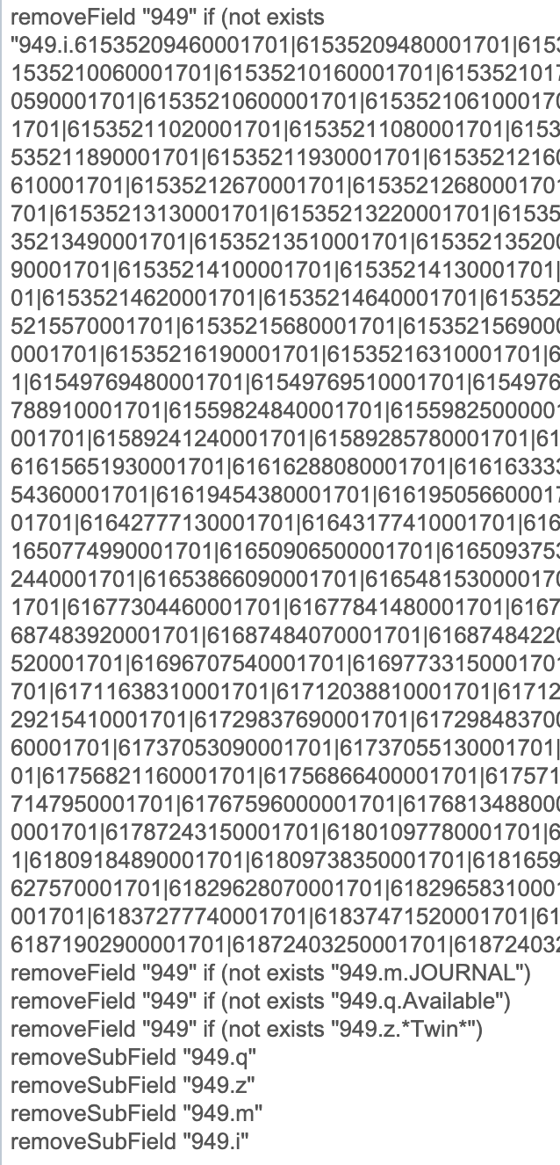
What that looks like
Notes:
Once i have my logical sets defined, I point the publishing profile to those. And I publish this extra information from what Rapid suggests.
I use the material type, activation status, collection ID, and available for campus subfields to filter by adding a normalization rule to the publishing profile which will remove any 949 field that doesn't meet certain criteria. The 949 field contains the information Rapid needs to make a request to you for a particular piece of content. I believe that's the standard field for electronic resources but I don't know that it necessarily has to be.
Over on the right, and I know this may be difficult to see on your screen, is a screenshot from my normalization rule for lendable e-journals. As you can see it will remove a 949 field if the electronic collection ID doesn't match this list. in this case, this is the international set, and I pulled the collection IDs off the Analytics report. At this time, this step is manual. But you can add them with an OR operator by inserting a |. And then I also have a remove if not JOURNAL, remove if not Available, and remove if the available for (group settings) data doesn't contain "Twin." This all works because I've added a few subfields to the publishing parameters.
If you recall way back at the beginning of the presentation I mentioned that we had instances where lendable and non lendable portfolios were on the same bib record. This normalization rule is how I ensure only lendable content is present in the lendable feed.
The 949 indicates what content you can lend. If you have a bib record in your OAI holdings feeds with no 949, that's the same thing as saying we can't lend it, even though it's in the feed. Rapid will ignore them because there's not a 949.

Slide 26
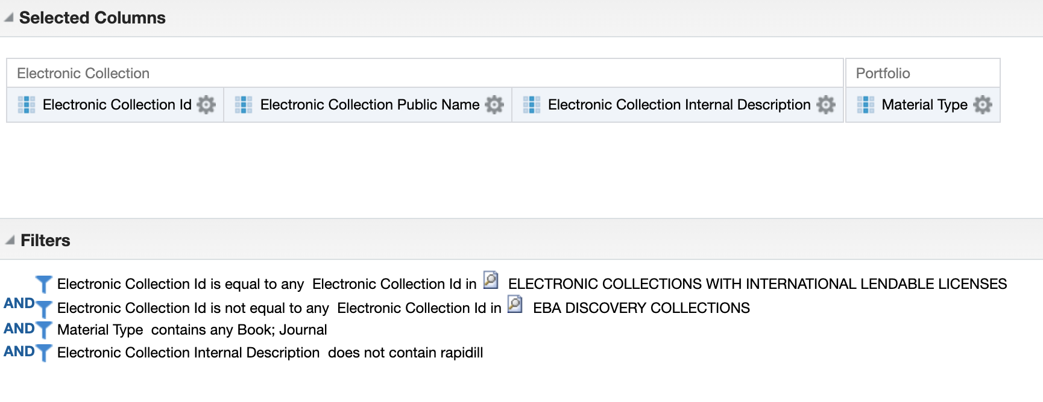
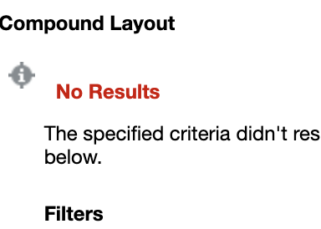
Keeping up with new collections
Notes:
So lastly, of course we're adding new collections, and license terms may change. How do I keep up?
I need to update electronic collection internal description fields with the tag, and also need to update the normalization rules for new collection IDs when possible.
So I set up a new report in Analytics. It looks to see where, for instance, a collection is lendable internationally according to the license terms AND the electronic collection internal description field does not contain the rapidll_international tag. This way I can get a quick report of just things I need to update, and then make the changes to the internal description field and the normalization rules.
It's pretty quick to look up an electronic collection and then add the internal description tag to it. Because I created the logical sets, they will automatically update with the new titles from the newly tagged collection. Lastly, because of the normalization rule that will strip things out that aren't from a specific list of collection IDs, I have to update my normalization rule with the new collection IDs. for new electronic collections that are lendable, I will copy those IDs and paste them at the end of the norm rule to make sure the new titles are not getting stripped out.
I ran this the other day while finishing the slides, and you can see I'm up to date on tagging collections - the no results means all the collections that are lendable internationally have been updated with the correct tag in ALma.

Slide 27
Conclusion and Next Steps
Having many reports that build into the final reports is complex, but easier to work with in many ways.
This process is still fairly involved to set-up, but maintenance is fairly light.
Moving towards more automation.
Notes:
Having many reports that build into the final reports is complicated to look at, but easier to work with in many ways. I find that one analysis that is extremely complex is hard to look at, hard to set up correctly especially if there's a lot of ANDs and ORs, hard to diagnose if something isn't working properly, and very easy to mess up.
This can be customized to suit your needs. Don't need international? Don't build a report. Not doing ebooks? Filter that out in Analytics before applying it in Alma.
I would like to automate more, and I have some ideas there using the APIs for everything but the actual updating in Alma. For instance, use the APIs to pull the data regularly on new collections to update (this could also just be a report I send to myself), or to use the APIs to pull the international lendable collection IDs from Analytics and format the norm rule with the right collection IDs in it, and then I just would need to go into Alma and paste the new rule over the old rule.
There are definitely probably easier ways to go about this for institutions without a consortium, or that don't have the extent of content that we do. However, hopefully some of this will be useful to you if you're considering going live with Rapid or already have, at least as a basic idea for how to adapt this to your environment. This process does look complicated, but it's not really that time consuming to operate which was part of the initial goal.

Slide 28
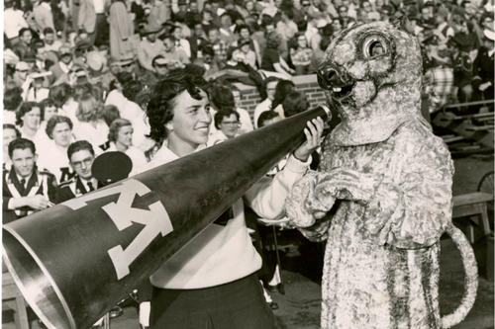
Questions?
email me: patri299@umn.edu
Slides available now: https://z.umn.edu/RapidLicenseAnalytics
Slides available later in ELUNA Document Repository
Notes:
Thanks for listening in, and if you have any questions you can use the Q&A tool, or send me an email later.
Slides are available now at the link here, z.umn.edu/RapidLicenseAnalytics, where the r and l and a are capitalized in the link.
And of course, the slides and the recording will be available to everyone in the ELUNAverse at some point soon.

